Slide 1
Decoding Bladder Cancer
Stage 1 to Stage 2 Pathway Enrichment and Immuno-Oncology Insights
Tashnuva Huda, Jay Nagabhairu, Tazeen Shaukat, Sam Zocher

Slide 2
Table of contents
01
02
03
04
Introduction
Summary of Analysis
Results
Pathway Analysis

Slide 3

Introduction to Bladder Cancer
Risks
Stages
Recurrence
Men are more at risk than women
Family history of bladder cancer
Certain genetic markers
Stage ‘0’:
cancer is found in the tissue lining the bladder
Stage 1:
Cancer has spread to connective tissue
Stage 2:
the cancer is invasive and has spread to the muscle
Recurrent bladder cancer is very common and often requires lifelong follow up. It is the most expensive form of cancer to treat.
Notes:
Stage 1: About 80% of people survive
Stage 2: About 45% of people survive

Slide 4
Goal
Understand the genetic and immunological differences between the stages of bladder cancer
In the future, more research in this area could inform effective treatment methods
Notes:
Overview of steps

Slide 5
Summary of Analysis
DGE Analysis
CiberSort
Draw Conclusions
Conduct differential gene expression
Perform Immuno-Oncology analysis in CiberSort
Research the relevance of biological pathways in bladder cancer
0
1
2
3
4
5
Identify Comparison Groups
Enrichment Analysis
Visualising Results
Run EnrichR analysis to identify relevant biological pathways
Create visualizations based on CIBERSORT results
Analysis 1:
Baseline: Precancer bladder cancer
Comparison: Stage 1 bladder cancer
Analysis 2:
Baseline: Stage 1 bladder cancer
Comparison: Stage 2 bladder cancer

Slide 6
CIBERSORT Analysis Results

Slide 7
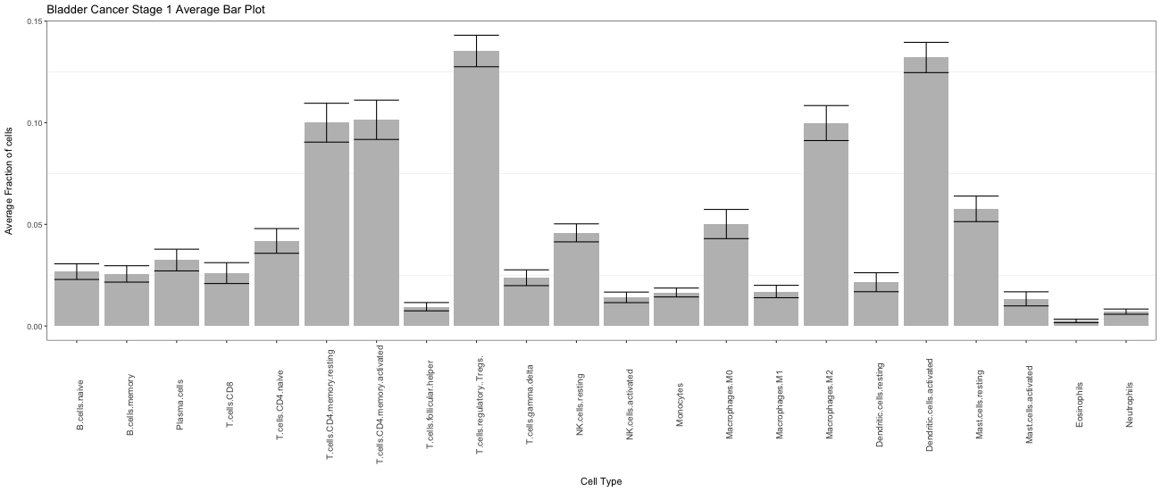
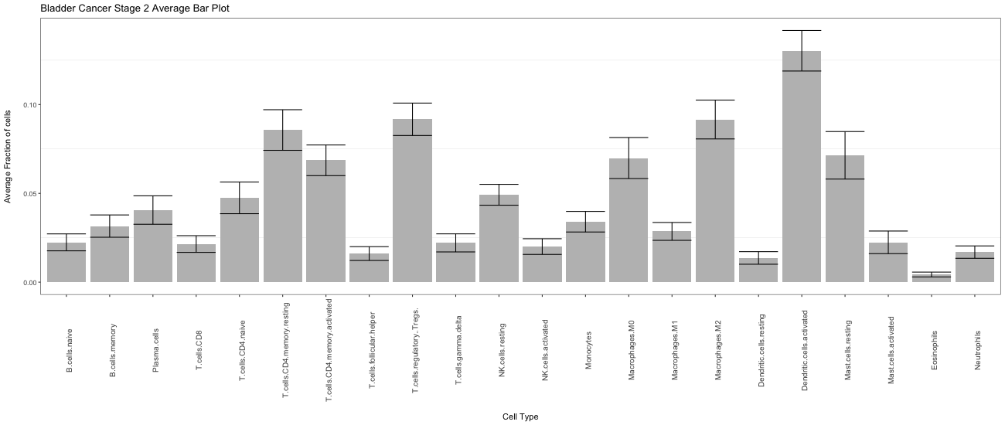
Average Bar Chart
B Cells:
Higher naive and memory B cell fractions in Stage 1.
T Cells:
Resting memory CD4 T cells and regulatory T cells (Tregs) are higher in Stage 1.
Notes:
tash

Slide 8
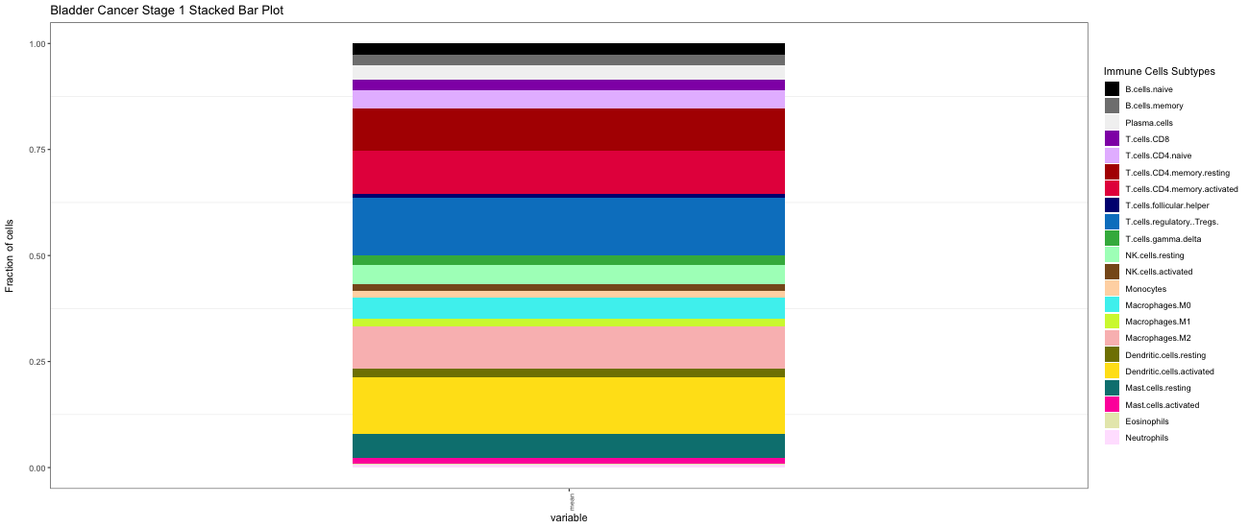
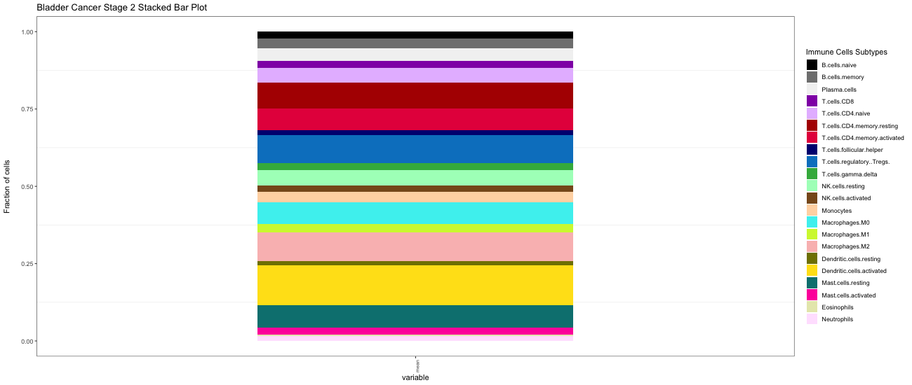
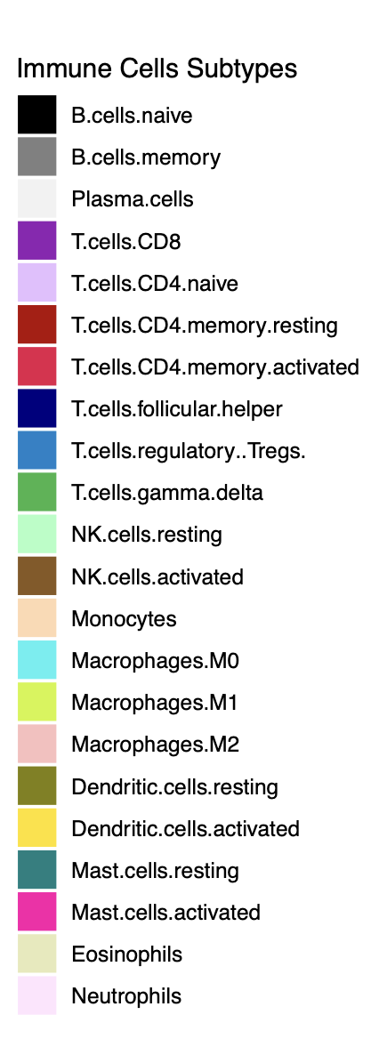
Stacked Bar Plot
Stage 1
Stage 2
Notes:
Stage 1:Active immune surveillance with higher resting memory CD4 T cells, Tregs, resting NK cells, and M1 macrophages. Indicates a more stable immune state with immune suppression playing a role.
Stage 2: Enhanced immune activation with higher activated memory CD4 T cells and activated NK cells. Increased M2 macrophages promote immunosuppression, possibly aiding tumor progression.

Slide 9
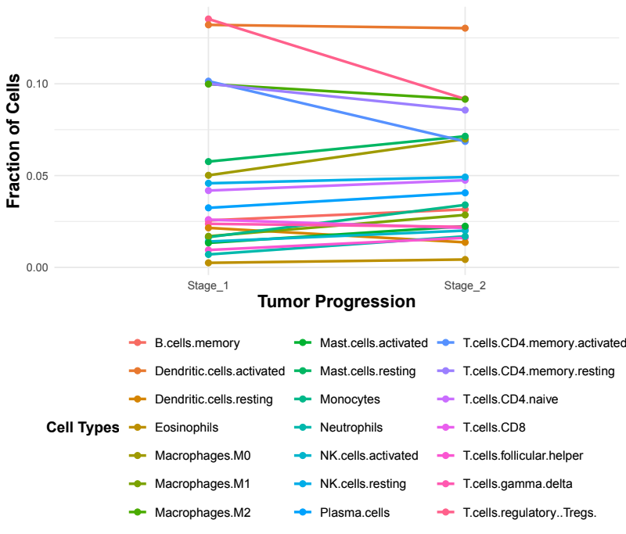
Line Graph
Notes:
Decrease B - cell memory → inhibits long term immune response
Increase M2 macrophages are anti-inflammatory and associated with immune suppression and tumor progression.
suggests a shift in macrophage polarization from pro-inflammatory (M1) to pro-tumor (M2) phenotypes.
Decrease in CD4+ T Cells
-indicates immune exhaustion or suppression in stage 2

Slide 10
Relevant Pathways

Slide 11
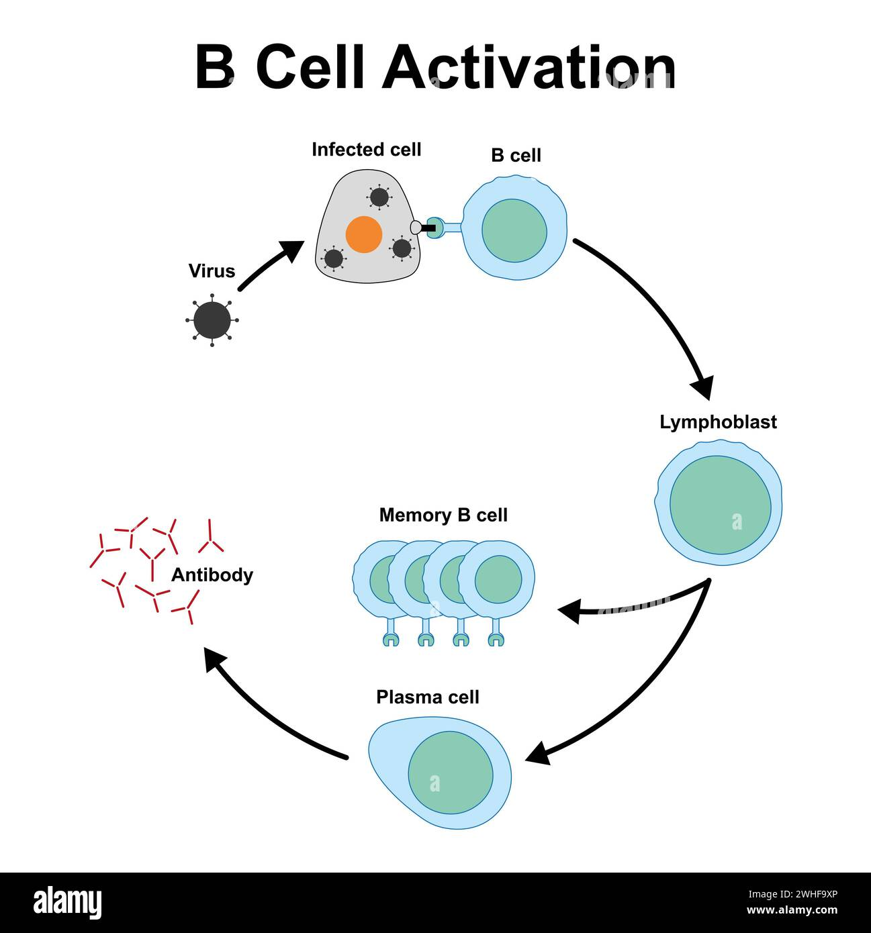
Negative Regulation of B Cell Activation
B Cell Activation Process
B Cells have receptors that bind to antigens
The presence of an antigen “activates” the B cell
T Cell can help activate as well
Once activated, B cells start dividing and produce antibodies
BREGS: Subset of B cells that regulate immune response
Source: Alamy Stock Photo

Slide 12
Negative Regulation of B Cell Activation
Genes Involved in Pathway: PARP3, SFRP1, ID2, TNFAIP3, CTLA4
Our analysis shows patients with stage 2 cancer have increased activity in the negative regulation of B cell activation pathway
Most of the genes involved have a positive fold change
Aligns with CIBERSORT results: lower concentration of B cells in Stage 2
Less B cells being activated leads to less effective immune response.
The tumor is able to grow
Connection to Bladder Cancer
BREGS and this pathway have been studied in other cancers but little is known about its relation to bladder cancer
Research on this pathway within bladder cancer aligns with our results but the specific genes involved differ

Slide 13
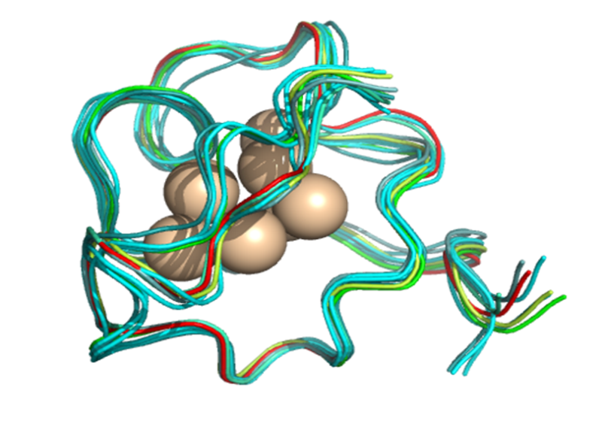
Metallothioneins Bind Metals
Genes Involved in Pathway: MT2A, MT1A, MT1M, MT1G, MT1X
Gene Overlap: 5 / 11
What are Metallothioneins (MTs) ?
Multifunctional metal-binding proteins (zinc, copper, cadmium)
small cysteine-rich
Protect against oxidative stress
Involved in cell growth and apoptosis
Relation to Bladder Cancer
MT 1 → Immune evasion
MT 2→ Chemoresistance
P-value: 5.05 x 10 ⁻⁵
Notes:
Essential metals like zinc are crucial for enzyme function, gene transcription, and neuronal activity.

Slide 14
Metallothioneins Bind Metals
Tumor Suppression | Tumor Promotion
Detoxifies heavy metals (e.g., cadmium, mercury), reducing DNA damage and oxidative stress | Enhances tumor cell survival by mitigating oxidative stress in the tumor microenvironment
Regulates zinc levels to maintain normal cell functions, preventing uncontrolled proliferation | Regulates zinc and copper availability for tumor cell proliferation and angiogenesis
Neutralizes reactive oxygen species (ROS), protecting cells from carcinogenic stress | Contributes to immune evasion by reducing ROS and impairing immune response.
Inhibits cell proliferation and metastasis in bladder cancer types | Binds chemotherapy drugs (Carboplatin, cisplatin), promoting chemoresistance.
May enhance apoptosis in early stages of tumor development | Supports extracellular matrix (ECM) remodeling by activating zinc-dependent enzymes like MMPs, facilitating invasion and metastasis.
Notes:
Zinc promotes MMPs → degrade EMC
Copper promotes angiogenesis → new blood vessel development

Slide 15
Positive Regulation of Apoptotic Process and Connection with Mast Cells/Macrophages
Dysregulation of apoptosis is a hallmark of cancer, including BLCA, as it enables cancer cells to evade death and proliferate uncontrollably.
Identification of P4HB as a Critical Driver in BLCA Progression:
P4HB promotes bladder cancer progression by:
Enhancing cell proliferation – cancer cells multiply rapidly.
Inhibiting apoptosis – cells avoid programmed death mechanisms.
Increasing migration and invasion – key factors in tumor progression and metastasis.
Experimental knockdown of P4HB suppressed tumor growth and induced apoptosis, indicating its potential as a therapeutic target for BLCA.
Clinical Relevance of P4HB in BLCA:
Prognostic Indicator: P4HB expression was directly associated with worse overall survival and disease progression in BLCA patients.
Biomarker Potential: P4HB could serve as a molecular biomarker to identify aggressive bladder cancer cases and monitor disease progression.

Slide 16
Positive Regulation of Apoptotic Process and Connection with Mast Cells/Macrophages
Genes Involved in Pathway: PDCD5, STK3, LGALS1, RASSF2, CASP8, PNMA1, CTSK, CCL3, E2F1, CTLA4, CTSH, PHLDA1, MAP3K5, TGM2, KLF11, JUN, GADD45B, DAB2IP, CLIP3, SFRP1, IL6;MELK, LATS2, BIN1, JMY, RNF122
Mast cells have a dual role in bladder cancer:
In early stages, they may support immune surveillance by releasing pro-inflammatory cytokines.
In advanced stages, mast cells release factors like vascular endothelial growth factor (VEGF), promoting angiogenesis, immune evasion, and tumor progression.
Secrete factors (e.g., histamine, proteases) that inhibit apoptosis in tumor cells.
Promote chronic inflammation, creating a favorable environment for tumor survival.
In Stage 1 BLCA, M1 macrophages are higher, contributing to active immune surveillance and increased tumor apoptosis.
In Stage 2 BLCA, there is a shift towards M2 macrophages, promoting immune suppression and tumor progression.

Slide 17
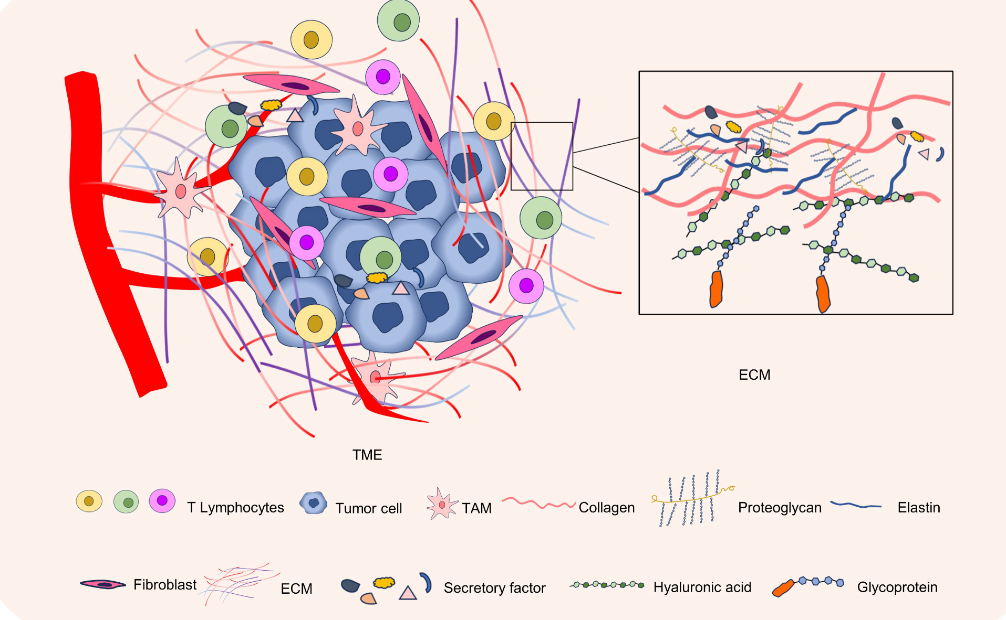
Neutrophils and Macrophages in Extracellular Matrix Organization
The Extracellular Matrix
The extracellular matrix is a complex network of proteins and carbohydrates located outside of cells, providing structural and biochemical support to surrounding cells and tissues.
It functions like the glue and netting that helps hold the bladder's shape and protect the cells inside.
In bladder cancer, this net (the ECM) can get reorganized, broken, or even used by cancer cells to grow and move around
Notes:
Tazeen https://pmc.ncbi.nlm.nih.gov/articles/PMC2717820/

Slide 18
Neutrophils and Macrophages in Extracellular Matrix Organization
Why is ECM important to Bladder Cancer?
Spreading (metastasis): When bladder cancer spreads, it uses the ECM as a kind of highway to travel to other places, like nearby tissues or organs.
Research indicates that changes in the ECM microenvironment is linked to bladder cancer progression from non invasive to invasive.
Tumor migration: Alterations in ECM components can create pathways that facilitate cancer cell movement to other tissues.
Notes:
Tazeen https://pmc.ncbi.nlm.nih.gov/articles/PMC7251326/

Slide 19


Neutrophils and Macrophages in Extracellular Matrix Organization
Neutrophils: The First Responders
Neutrophils release enzymes to degrade/break ECM components.
This degradation creates pathways for neutrophils and other immune cells to move through tissues, facilitating their response to infection or injury.
This degradation also facilitates the movement of cancer cells through tissues, aiding in metastasis.
Macrophages: The Clean Up Crew
“Good” Macrophages are supposed to rebuild the ECM
Tumor Associated Macrophages (TAMS) can help cancer grow by remodeling the ECM to make it easier for tumors to grow and spread.
TAMs create a fertile ground for tumor cells in neighboring tissues or organs to welcome cancer cells by remodeling the ECM
Notes:
Tazeen
TANS: https://pmc.ncbi.nlm.nih.gov/articles/PMC8529570/
TAMS: https://www.frontiersin.org/journals/immunology/articles/10.3389/fimmu.2020.553967/

Slide 20
Neutrophils and Macrophages in Extracellular Matrix Organization
Genes Involved in Pathway:
COL18A1, COL15A1, PTPRS, LAMA4, ICAM1, ADAMTS4, ADAMTS2, CAPN9, CAPNS2, CTSK, TIMP2, ITGB6, ACTN1, MMP3, ASPN, COL1A1, ADAM19, COL3A1, VCAN, COL4A2, LOX, COL5A1, COL4A1, COL5A2, COL6A3, ITGA5
Previous Research Aligns well with our Analysis:
Extracellular Matrix: Increased ECM-related gene expression from Stage 1 Bladder Cancer to Stage 2
Indicates that ECM remodeling is playing a key role in progression to invasive tumor
Relevant Immune Cells: Fraction average for pro-inflammatory macrophages decrease from Stage 1 to Stage 2, whereas anti-inflammatory macrophages (m2) slightly increase from Stage 1 to Stage 2
For m1: Could suggest immune evasion mechanisms at play
For m2: Could reflect a shift in macrophage polarization from pro-inflammatory (m1) to pro-tumor (m2) phenotype
More research is required to confirm the potential immuno-therapeutic opportunities
Notes:
Tazeen https://pubmed.ncbi.nlm.nih.gov/35450397/
https://molecular-cancer.biomedcentral.com/articles/10.1186/s12943-023-01744-8

Slide 21
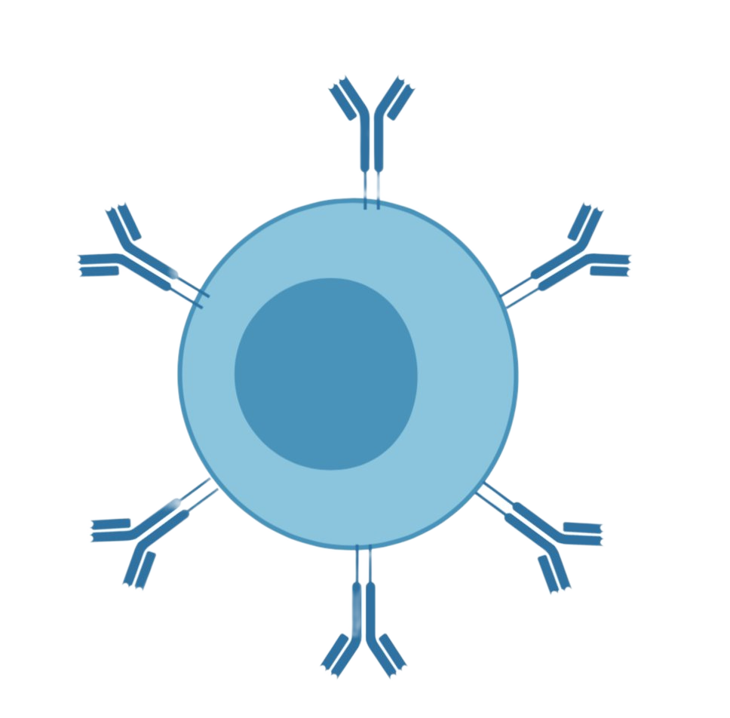
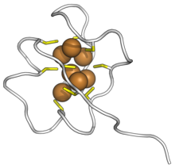


Conclusion
Positive Regulation of Apoptosis
Negative B Cell Activation
Extracellular Matrix Organization
Metallothioneins Expression
The role of relevant immune cells in these pathways show promising evidence that they might contribute to to not only tumor progression but also tumor recurrence in regions different from origination.
More research is needed to inform development of therapies targeting the immune microenvironment for treating disease progression in BLCA.
Notes:
Hope to do a wide comparative analysis and include our other analysis between precancer and stage 1

Slide 22
In Conclusion
Negative regulation of B Cell activation,
Role of MTs in tumor suppression in stage 1 and progression in stage 2,
Function of Mast Cells and Macrophages in the positive regulation of apoptotic processes, and
The role of Neutrophils and Macrophages in extracellular matrix organization
All show promising evidence that they might contribute to to not only tumor progression but also tumor recurrence in regions different from origination.
More research is needed to inform development of therapies targeting the immune microenvironment for treating disease progression in BLCA.
Notes:
Overview of steps

Slide 23
References
Bladder cancer causes and risk factors. NCI. April 27, 2023. Accessed December 18, 2024. https://www.cancer.gov/types/bladder/causes-risk-factors.
Sung HC, Chang KS, Chen ST, Hsu SY, Lin YH, Hou CP, Feng TH, Tsui KH, Juang HH. Metallothionein 2A with Antioxidant and Antitumor Activity Is Upregulated by Caffeic Acid Phenethyl Ester in Human Bladder Carcinoma Cells. Antioxidants (Basel). 2022 Aug 1;11(8):1509. doi: 10.3390/antiox11081509. PMID: 36009228; PMCID: PMC9405133.
Zhao H, Chen Z, Fang Y, Su M, Xu Y, Wang Z, Gyamfi MA, Zhao J. Prediction of Prognosis and Recurrence of Bladder Cancer by ECM-Related Genes. J Immunol Res. 2022 Apr 12;2022:1793005. doi: 10.1155/2022/1793005. PMID: 35450397; PMCID: PMC9018183.
Zhou, J., Zhou, R., Zhu, Y. et al. Investigating the impact of regulatory B cells and regulatory B cell-related genes on bladder cancer progression and immunotherapeutic sensitivity. J Exp Clin Cancer Res 43, 101 (2024). https://doi.org/10.1186/s13046-024-03017-8

Slide 24
Thank you!
QUESTIONS?

